Slide 1
CoSign firmas digitales. Como acelerar los procesos de firma en la empresa
Daniel Translateur
Gerente de Ventas Iberia

Slide 2
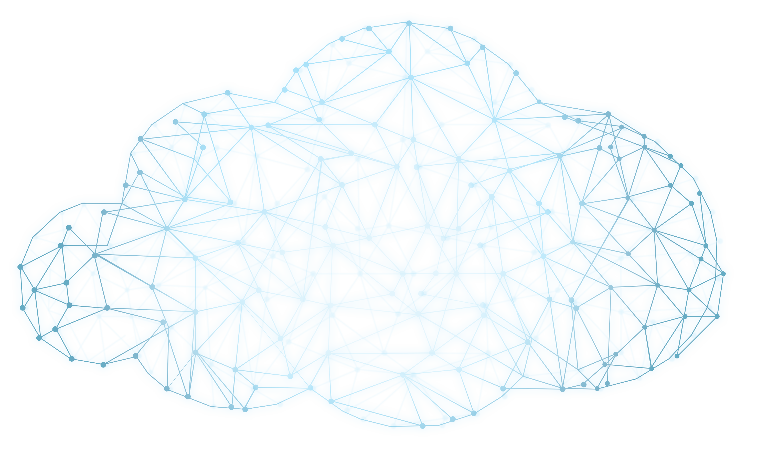
Trust
DocuSign Global
Network

Slide 3
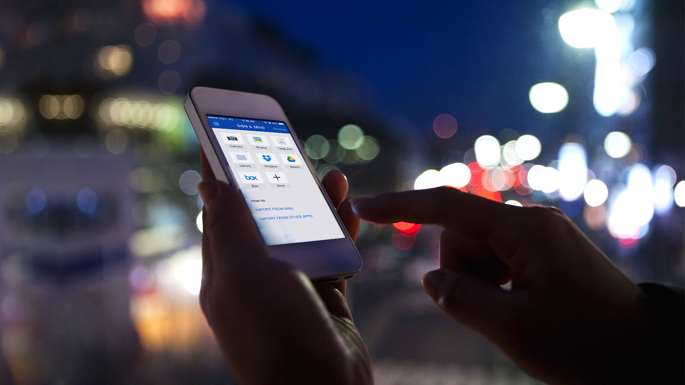
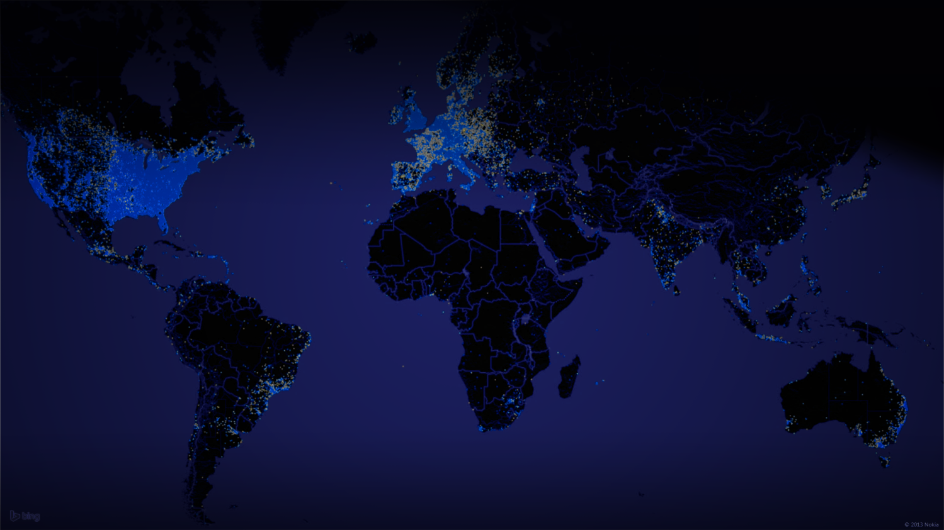

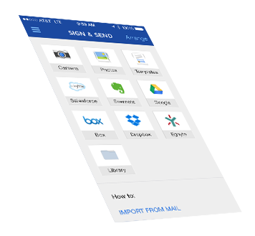
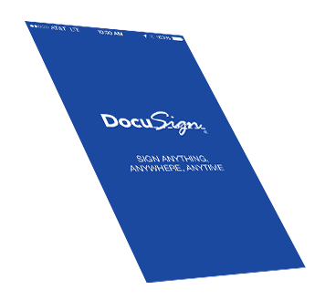

Every .04 seconds a
Document is signed
via DocuSign
Confianza
10+ Años de innovación
Microsoft Strategic Partner
Global
188 Países “DocuSigned”
43 Leguajes
Oficinas en los 5 continentes
Líder
140,000+ Empresas
50M+ Usuarios/ 50K Nuevos usuarios diarios Cloud
~20M on premise
#1 En Rating de los Analistas
Notes:
<Hopefully many of you are familiar with DocuSign>
What you may not know about DocuSign is that…
Trusted
We invented cloud-based eSignature in 2003. And we’ve expanded our solution beyond eSignature to include any of your business transactions that still aren’t digital.
Because organizations are running mission critical transactions, we provide the highest levels of availability and security capabilities in the industry (Carrier grade available/ Bank grade secure)
We are proud to have a strategic partnership with Microsoft
Global
Users in 188 countries have DocuSigned
Service available in 43 languages
Leader
Over 120,000 paying customers ranging from to complete mission critical digital transactions with their customers
Adding 50,000 new users daily
#1 with analysts Forrester, Gartner, and Ombud
<some examples of our customers include……>

Slide 4
ERP ECM CRM HRM SCM LOB
Empresa /
Organización

Slide 5
Consumidores
Clientes
Partners
Empleados
Empresa /
Organización
Proveedores

Slide 6

Consumidores
Clientes
Partners
Empleados
Empresa /
Organización
Proveedores

Slide 7
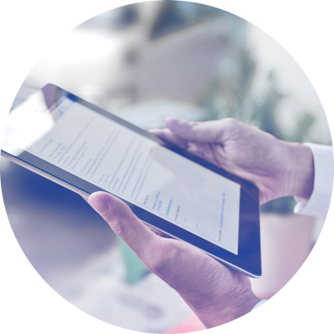
Consumidores
DTM
Clientes
Partners
Empleados
Empresa /
Organización
Proveedores

Slide 8



Delivered Value for Customers
ROI
Experiencia del cliente
Conformidad
$19.53 ahorro por documento
60% reducción de tiempo en enviar y recibir los documentos
50% de los contratos son 100% automatizados
Los clientes firman y activan su cuenta en mitad del tiempo
El equipo de ventas puede llegar a 2X de oportunidades
Integración con su CRM creando procesos automáticos
50% de reducción de errores
Centralización del 100% de los documentos de forma digital
Aumenta el uso de SalesForce en 300%
Notes:
Talk through customer examples

Slide 9
Por qué nuestros clientes escogen DocuSign?
Altos niveles de seguridad
La plataforma mas potente en el mercado
Rico ecosistema de Partners
The Global Standard for DTM
Producto Fácil de usar
Servicio en los 5 continentes

Slide 10

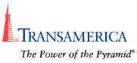
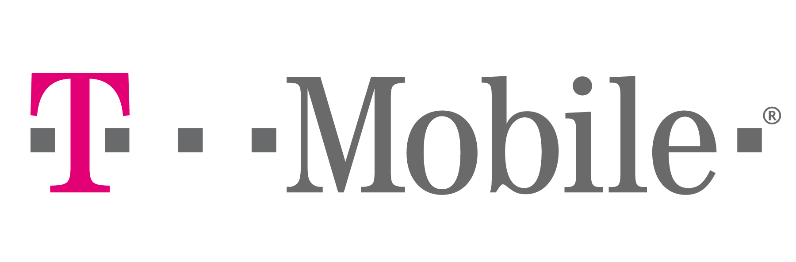
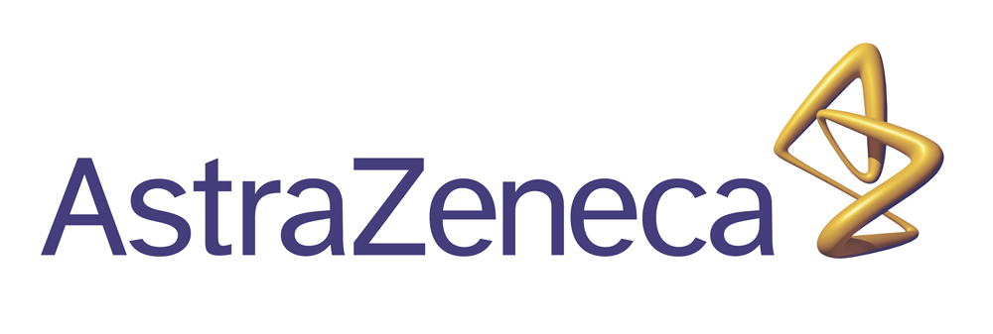





























Across Industries
Comunicación /Media
Medicina/
Pharma
Banca
Seguros
High Tech
Finca Raiz
Retail
ETC
Notes:
Point out additional customer stories from companies/industries that are relevant

Slide 11






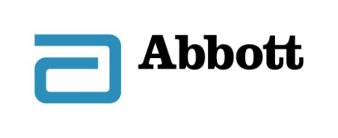





















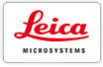











Millones de usuarios en Europa y el mundo
Terrassa Municiaplity
University of Barcelona
City of Amsterdam

Slide 12
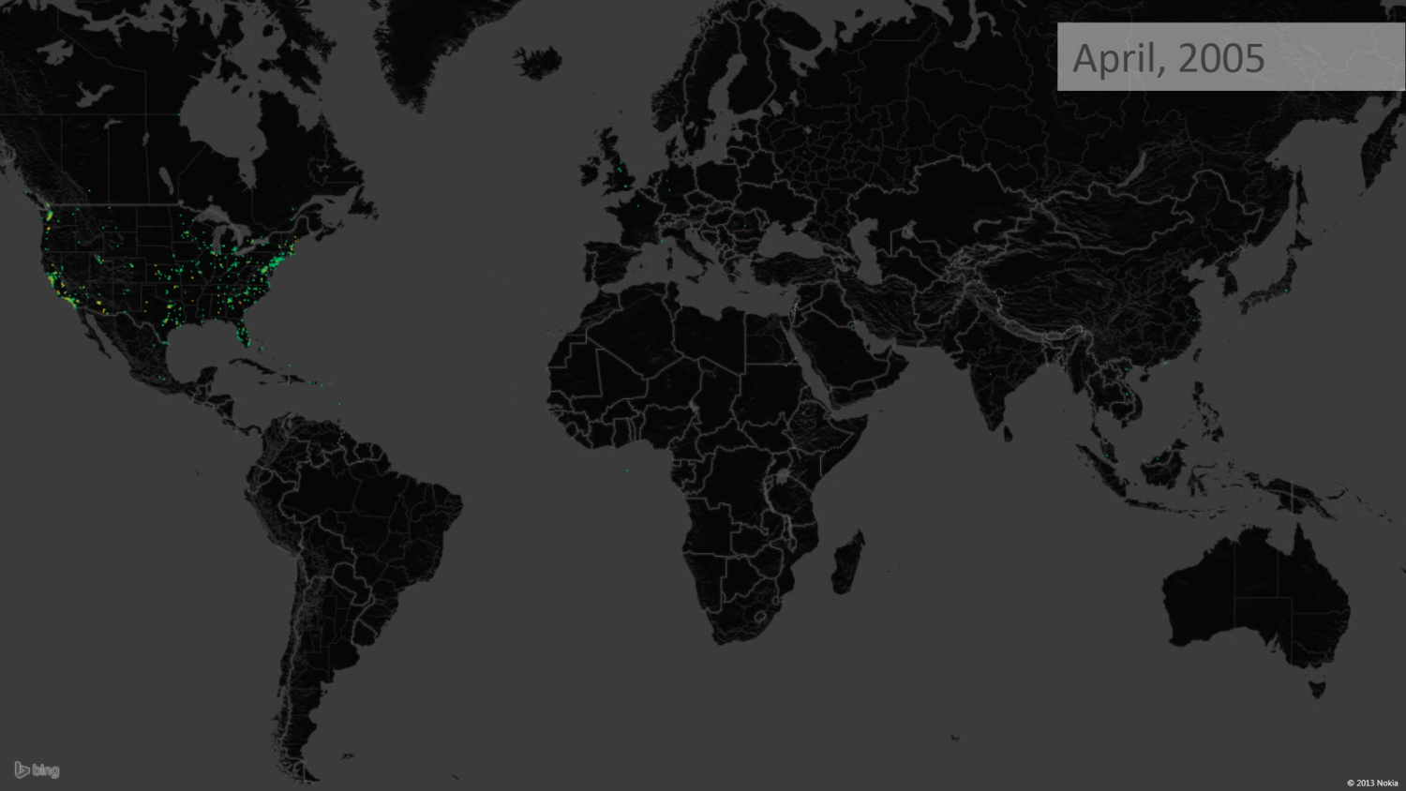
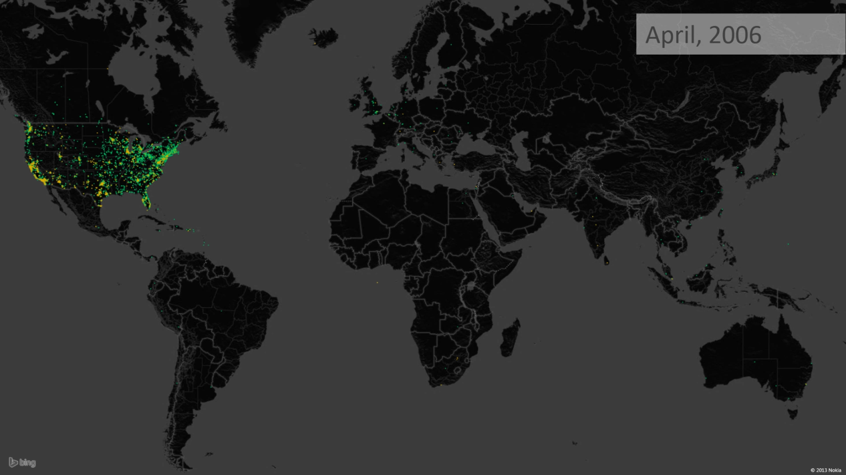
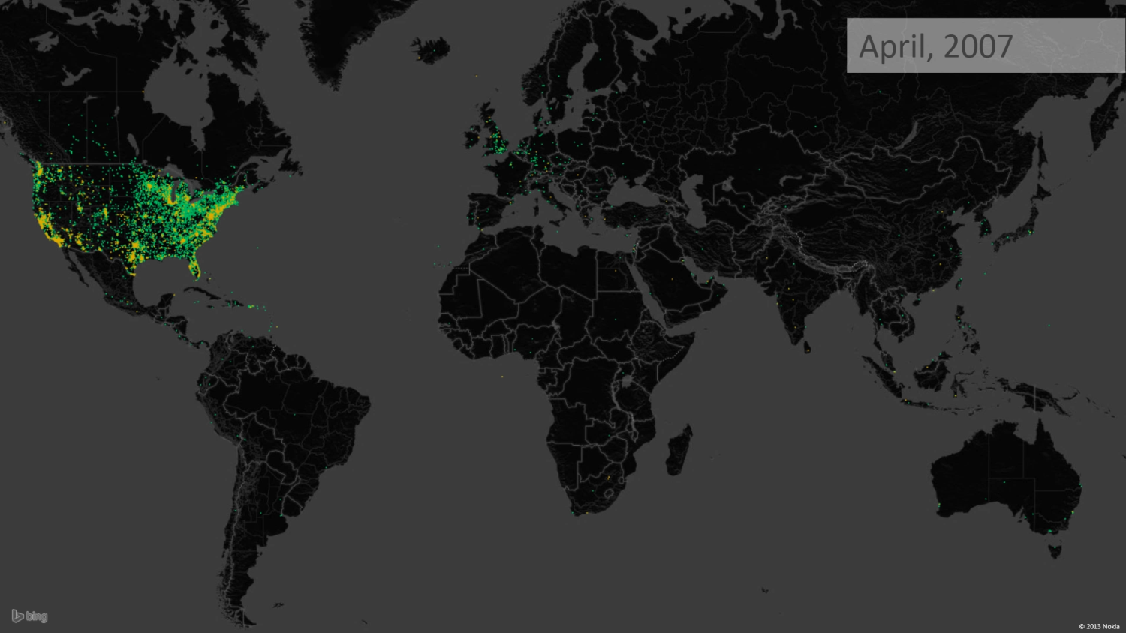
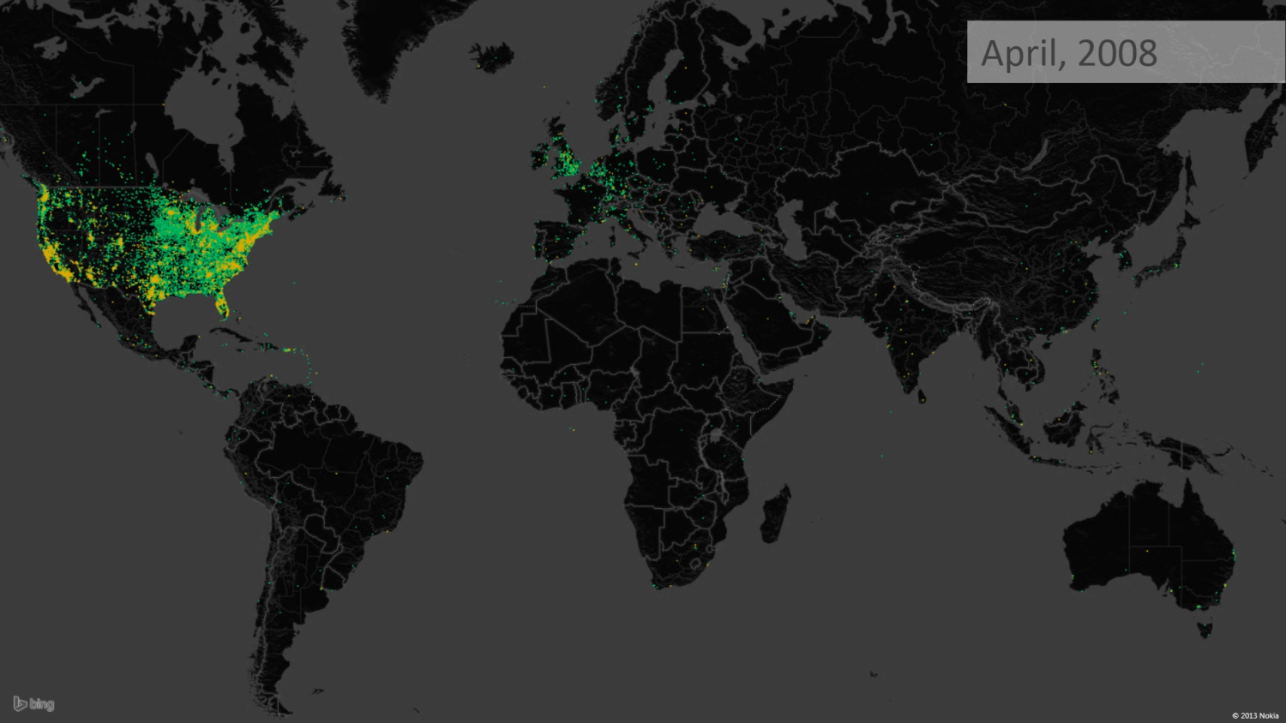
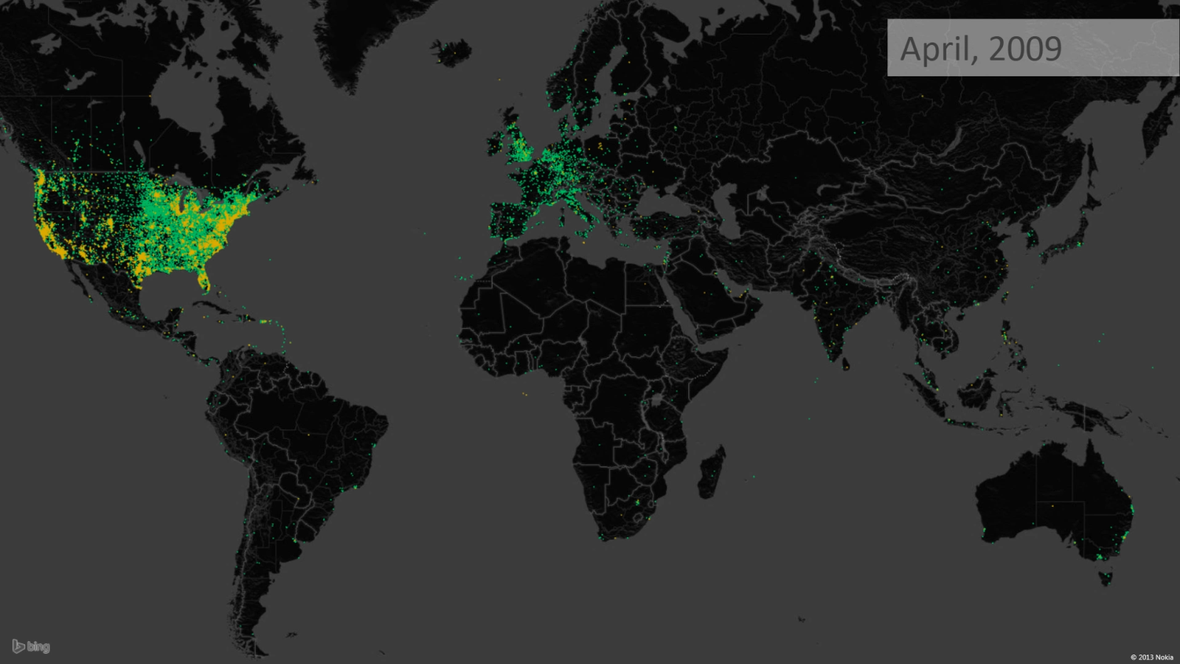
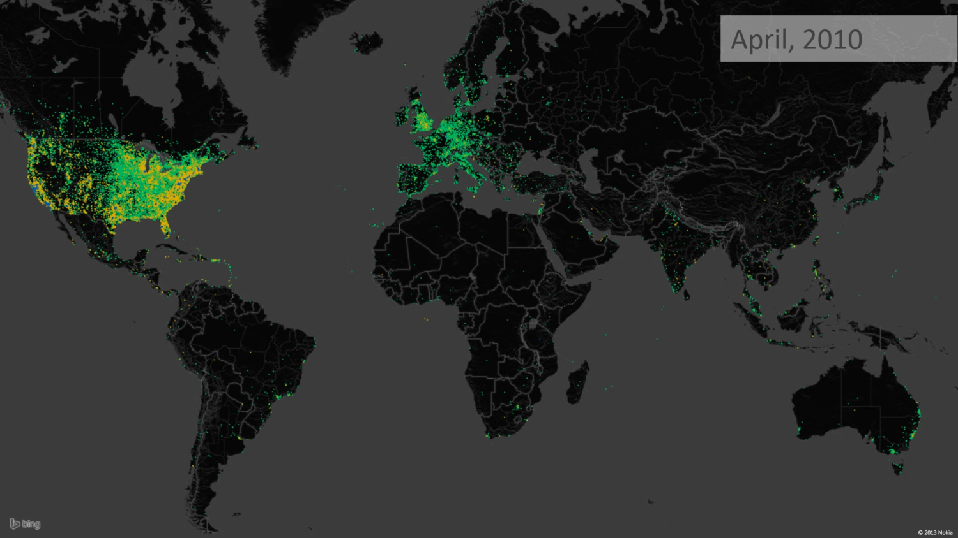
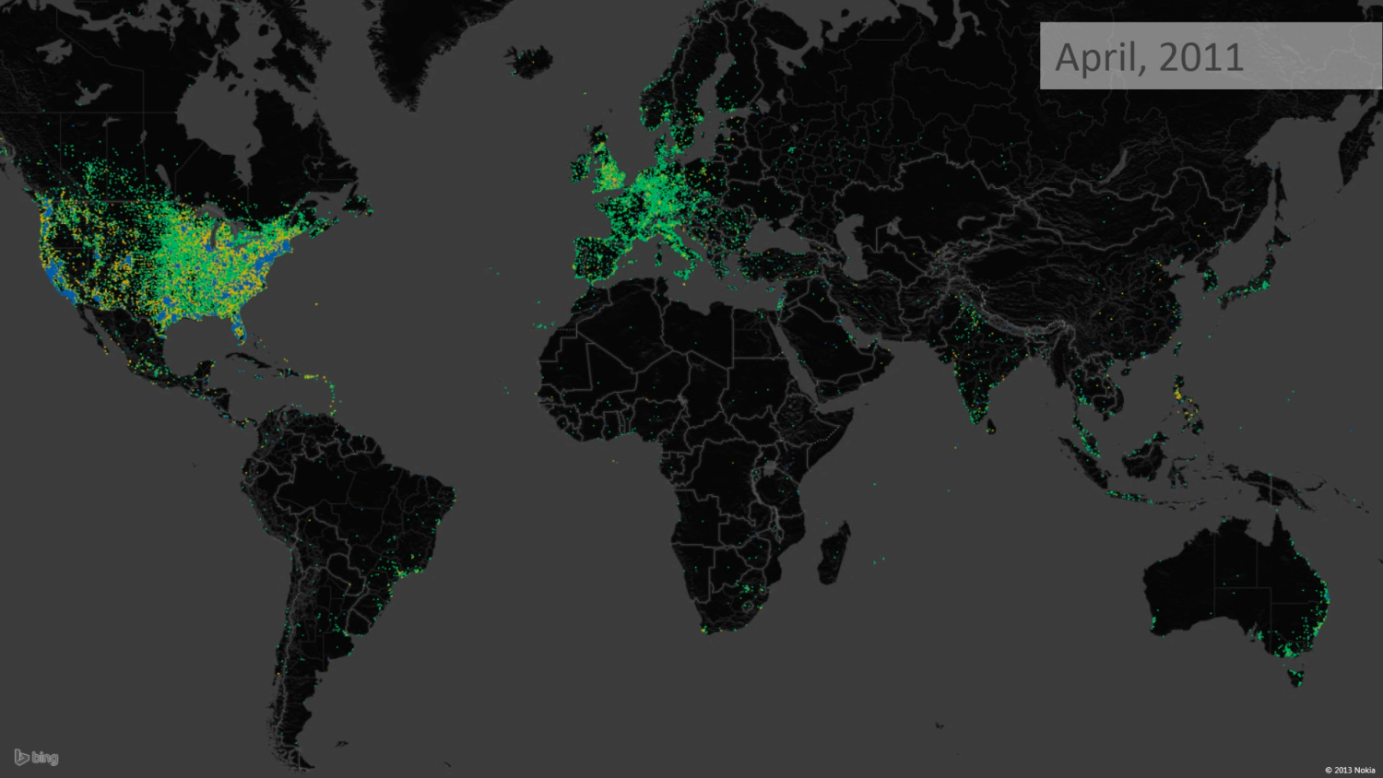
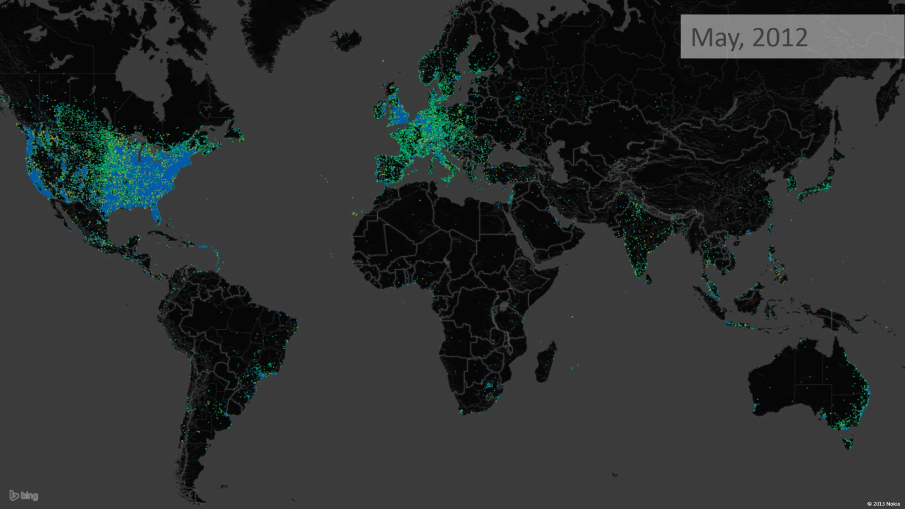

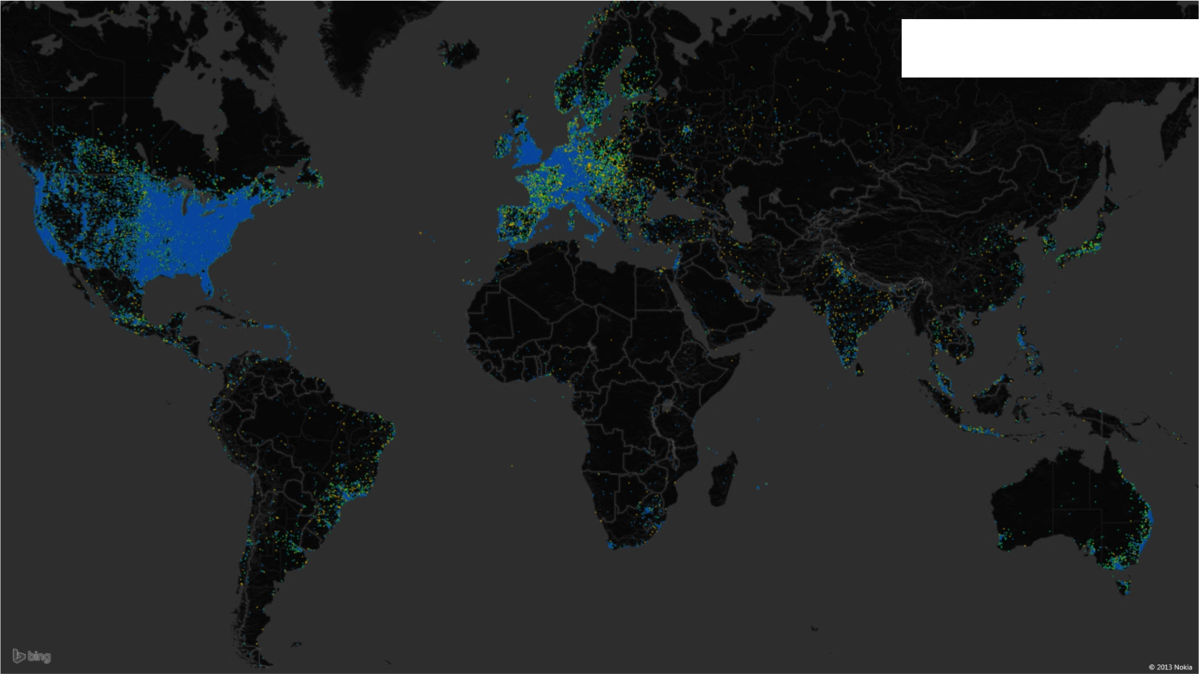
June, 2014
Sends
Sends
Sends
Sends
Sends
Sends
Sends
Sends
Sends
Sends
Web App Signs
Web App Signs
Web App Signs
Web App Signs
Web App Signs
Web App Signs
Web App Signs
Web App Signs
Web App Signs
Web App Signs
Mobile Signs
Mobile Signs
Mobile Signs
Mobile Signs
Mobile Signs
Notes:
HP is just one example of customers that have successfully deployed digital transaction management. Digital transactions is quickly spreading like wildfire. This time-lapse maps depicts the spread of DocuSign usage across the world. The blue dots that you see represent transactions conducted in DocuSign from a mobile device!
We’re building a network that enables frictionless business, anytime, anywhere, anyplace – literally in every corner of the world.
In working with organizations around the world, they are telling us that the most critical part of DocuSign is that we are able to accelerate transactions, reduces costs and enhance the user experience for customers, partners, suppliers and employees.

Slide 13


Trust
Cloud
Front Office, Firmantes externos
DocuSign eSignature, PKI o eID Technology
On-Premises
Back Office, firmantes internos
PKI-Standard Digital Signature

Slide 14
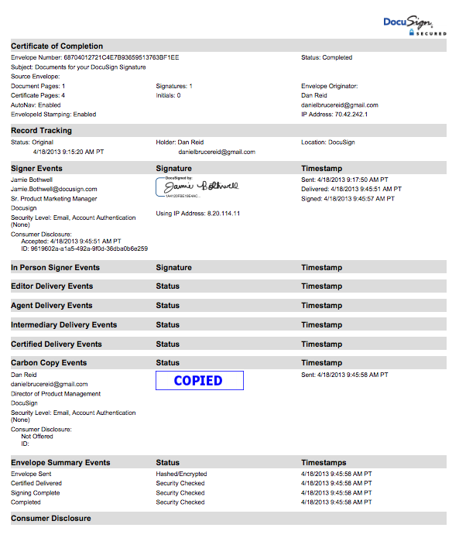
Seguridad gracias al uso de doble factor de autenticación y auditoria del proceso
Authentication
Audit Trail
KBA or In-Person
Primary
Multifactor add-ons
Email Address
Access Code
Web ID
ID Check
DocuSign Account
SMS
Social ID
Electronic Notary
Federated/SSO
Phone
Digital Cert
Industry-Leading Choice of Authentication Options
Notes:
Two of the most important factors in verifying whether a digital transaction is trusted, are proper signer authentication and a complete audit trail of what happened during that transaction. These two elements in a tamper-sealed package are the key evidence that supports the legal enforceability of signed document.
DocuSign leads the industry by a wide margin in the number of authentication methods and flexibility in authentication configuration offered to verify the identity of a signer. We offer multiple access methods for signers, including email address, a DocuSign account, and Single-Sign On integration, and give our customers the ability to add multiple layers of authentication to provide additional certainty of a signer’s identity from easy-to-use multifactor add-on methods like SMS authentication or biometric voice prints to knowledge-based authentication or in-person witnessed signing through electronic notary.
This flexibility in matching the level authentication to transaction risk is a key capability for both legal enforceability and complying with regulations in industries like financial services or healthcare.

Slide 15




Portfolio DocuSign Nativo de Firma Digital
Firma Digital DocuSign
Servicio de firma digital de terceros
Centralización Local de Certificados
Smartcard o Token
Cloud
eSignature
Firma digital basada en PKI
Certificados reconocidos/qualificados en tercero de confianza.
On Prem firma digital Con Terceros de confianza
Uso de su certificado personal
Most widely used eSignature
ICP Brasil, National ID, PIV/CAC, etc.
Express
Notes:
CoSign Central, as a solution, adds to DocuSign’s industry-leading portfolio of native digital signature solutions. Whether you are looking for a simple, industry-standard digital signature solution from DocuSign, to using third-party certificates, either in the cloud, in your data center, or on existing physical devices, DocuSign now has a solution that can meet your needs.

Slide 16
Can you use CoSign digital signatures? Yes!
EU Common Criteria EAL4+ certified
Fully complies with the 2014 EU ‘Electronic Identification and Trust Services for Electronic Transactions in the Internal Market’ (eIDAS) regulation
EU Common Criteria EAL4+ certification
EU CEN/TS 419241 with level 2 security
UK: Electronic Communications Act 2000
UK: Electronic Signatures Regulations 2002
FDA CFR 21 part 11

Slide 17
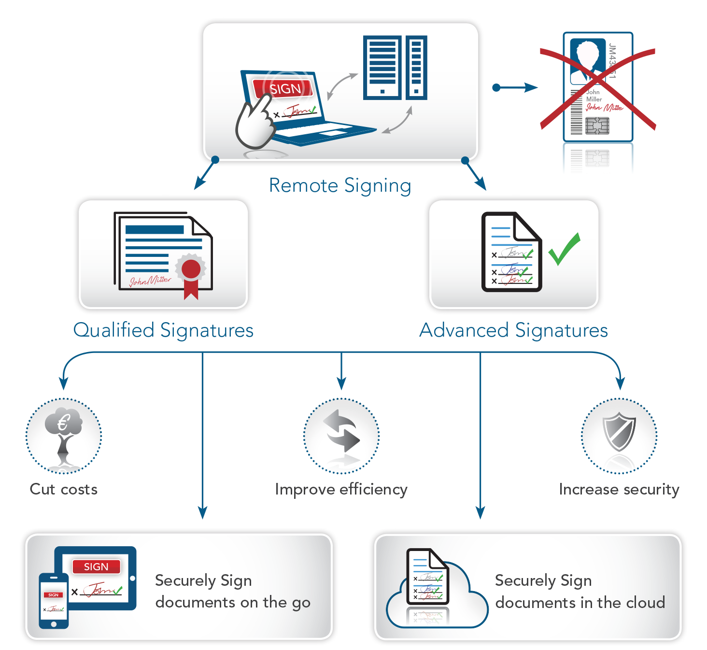
eIDAS Regulation

Slide 18





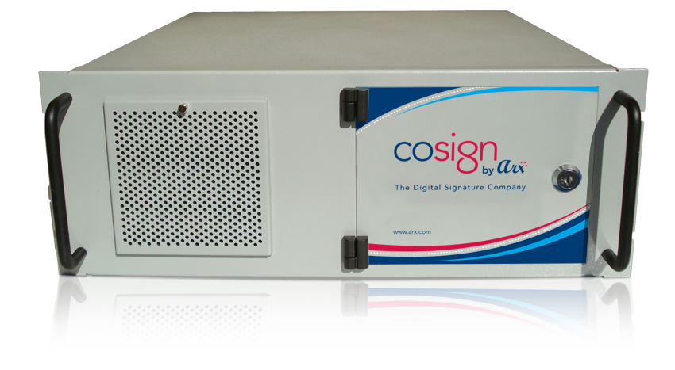




System Architecture
User/Subscriber Directory/DB
Admin
Central Control over Signature Privileges
End-Users
Policy & Procedure: Employee or Subscriber Onboarding/Revocation
Securely Request Signature Services
User-management Policy (directory/DB) drives signature-privilege management. Signature credentials (keys & certs) maintained in secure appliance.
Desktop Apps
FIPS 140-2 level 3 Secure
Secure Response to Requests
Web Apps
CoSign = Turnkey Solution (deploys in ~2 hours)
Mobile Apps
Built-in Management for Certificates (CA)
Built-in Key-Management; Private-key Operations
Graphic-Signature Management

Slide 19
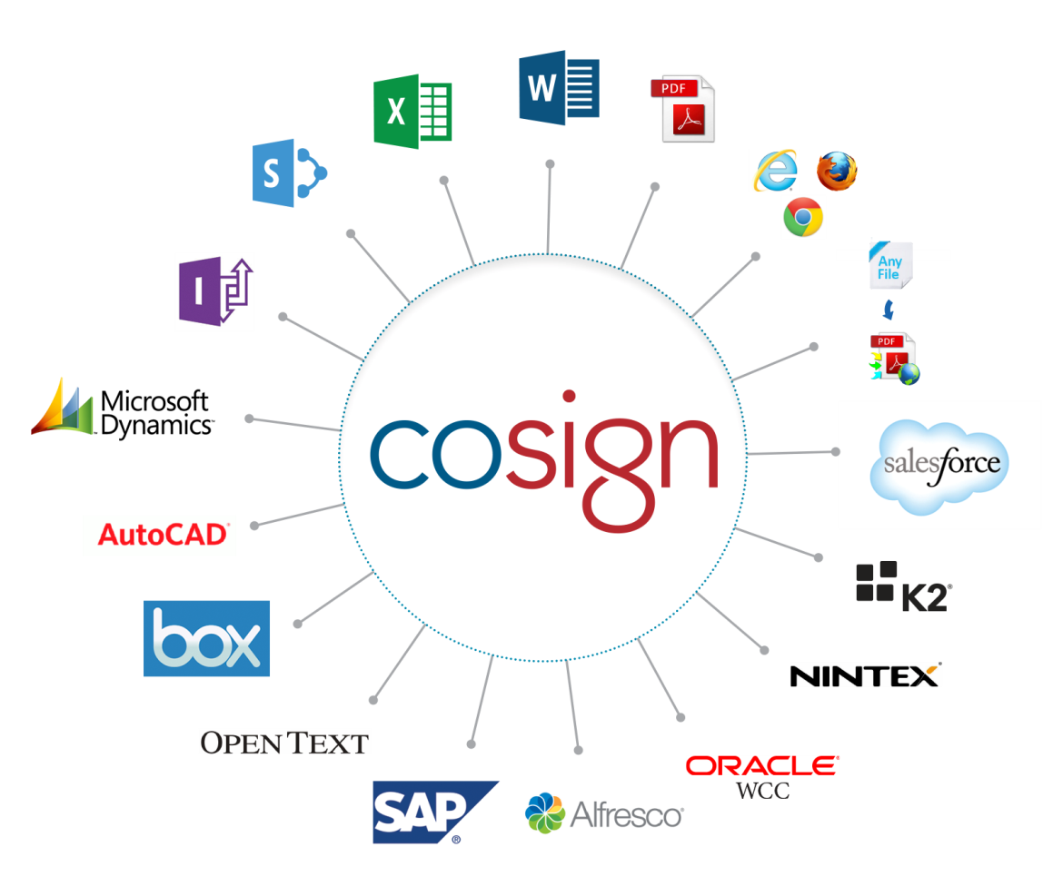
Complete Freedom of Choice

Slide 20

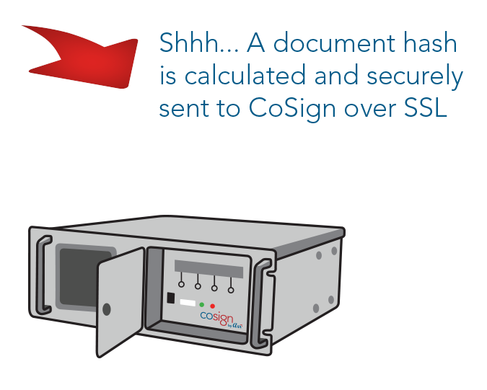
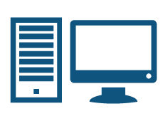

CoSign Connector for SharePoint - architecture
CoSign Agent
SharePoint Plugin
Signature Request/Response
CoSign
Appliance
SharePoint
Farm
SharePoint servers are members of the domain
CoSign is a member of the domain
Active Directory
User and client machine are members of the domain
Sign through CoSign connector for SharePoint
Direct Signing
End user

Slide 21
Live Demo Offer Letter Internal & External singers

Slide 22
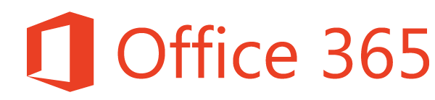

Office 365 Signing Demo
Update a letter using Word Online
Sign from Office 365 / SharePoint Online
Verify the signature from desktop Word

Slide 23




Two Party signing— Offer Letter workflow
Two party offer letter (contract) signing
CoSign digital signatures
Internal signer
External signer with 2 factor authentication and one-time password via SMS message
Kevin enters Susan’s data
Bill signs the offer letter
Susan authenticates via an SMS message and signs
Signed letter is stored in the SharePoint system
Bill reviews the signed letter
Kevin, HR Administrator
Susan, new engineer
Bill, HR Manager

Slide 24
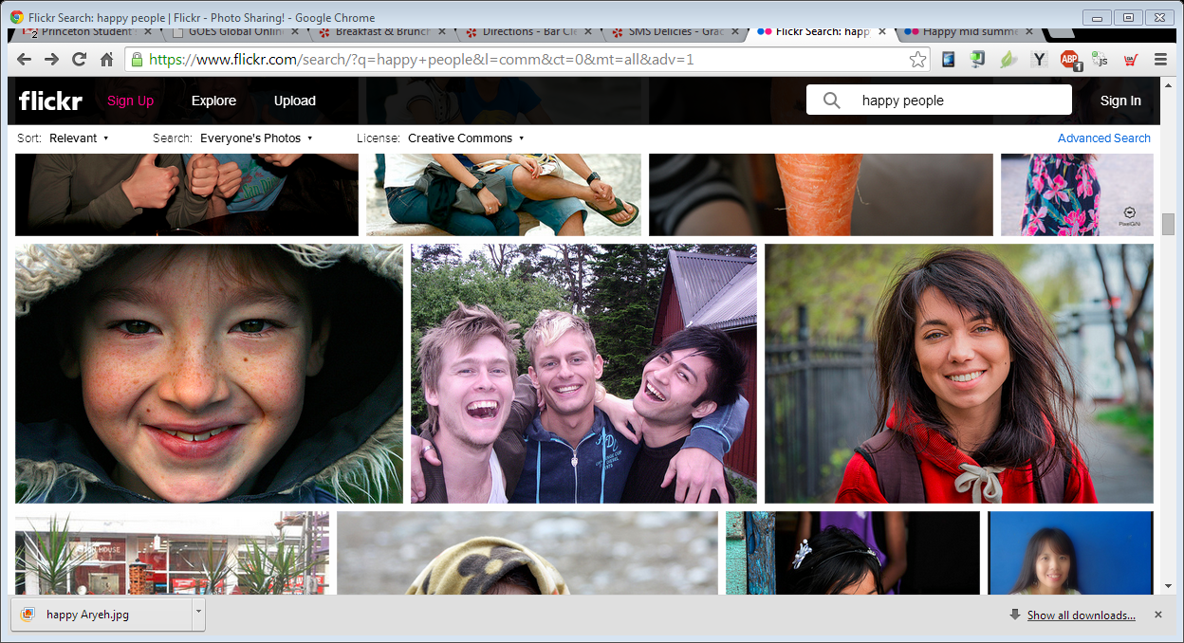
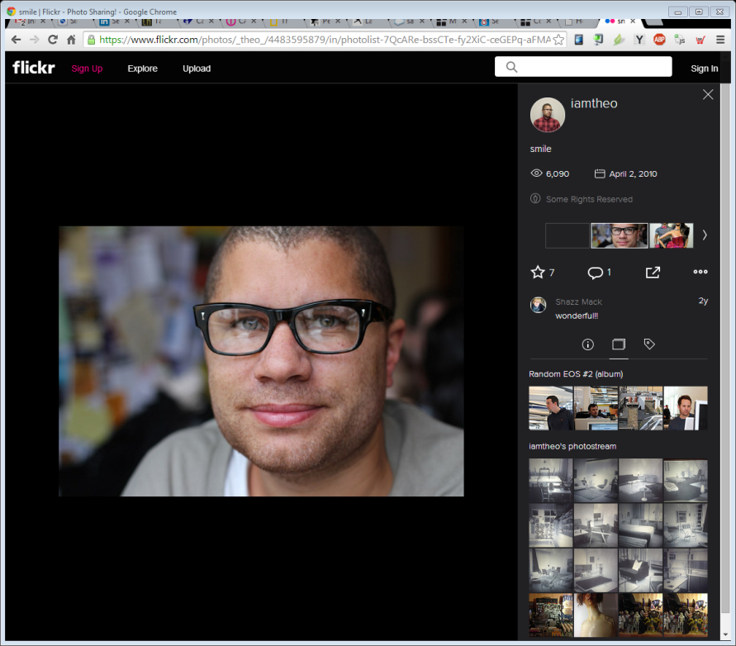
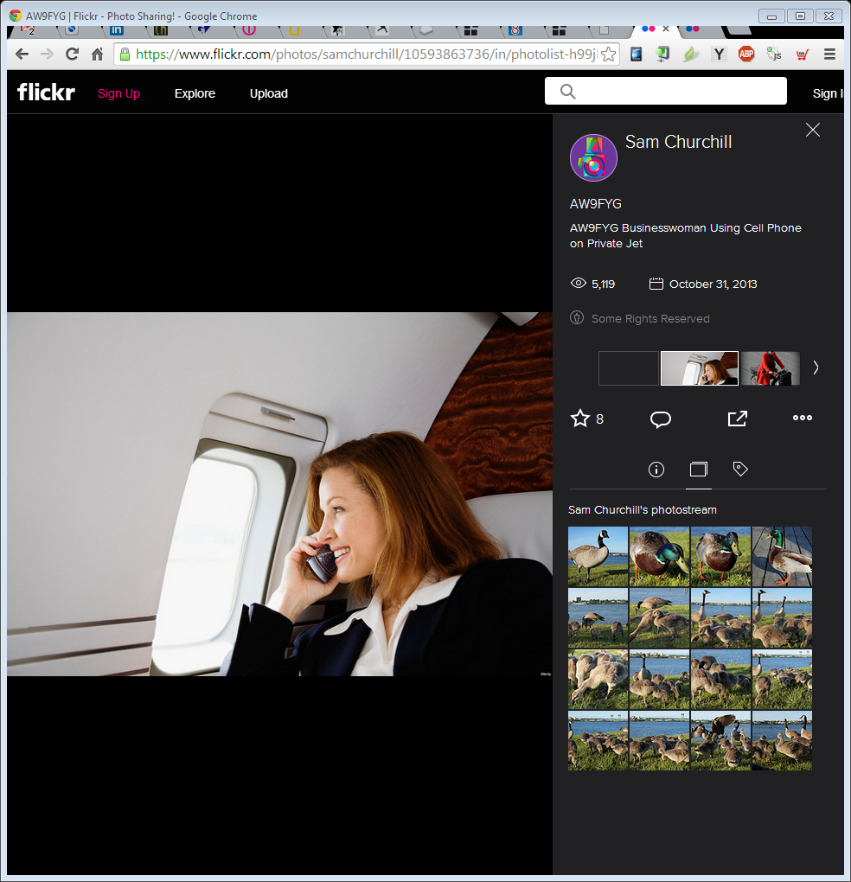
Internal, Partner & External Signers
GUIDANCE (Pls delete):
Under construction, you can change it for your own purpose
Internal signers—signer works for the organization.
Partner signers—”Extranet” apps for trusted suppliers, contractors, external staff Eg Vendors, DOT contractors, hospital doctors. Long term relationships with signers.
External signers—one-time or infrequent signers. Eg customers, patients, clients, new hires who are not yet in the corporate systems.

Slide 25

Your Most Successful SharePoint Project
Happy users
Happy managers: Better understanding of their business processes
Happy IT: Expand quality use of SharePoint
Happy Execs: save money, speed the organization

Slide 26
Daniel Translateur +972542448567 danielt@arx.com
Thank you

Slide 28






Digital Signatures Overview
Asymmetric scheme for sign and verify
Signing
110110101100
Hash
Function
Encrypt hash using signer’s private key
Signature
110110101100
Attach
to data
Digitally
Signed data
Data
Hash
Data
Verification
110110101100
Decrypt using signer’s private key
110110101100
Signature
=
?
If the hashs are equal, the signature is valid
Digitally
Signed data
110110101100
Data
Hash Function
Hash

